Slide 1

ZIAUDDIN UNIVERSITY Faculty of Engineering, Science, Technology and Management Department of Electrical Engineering BS Computer Science
Batch 2023
PROPOSAL PRESENTATION HAND GESTURE GYRO ROBOT CAR
Group members
Supervisor name / course teacher
M. Saleem Ahmed (4-38/2023/029)
Shahnil Sharma (4-38/2023/004)
Anas Imtiaz (4-38/2023/039)
Mussaddir Ali (4-38/2023/039)
Dr.Engr.Munaf Rashid

Slide 2
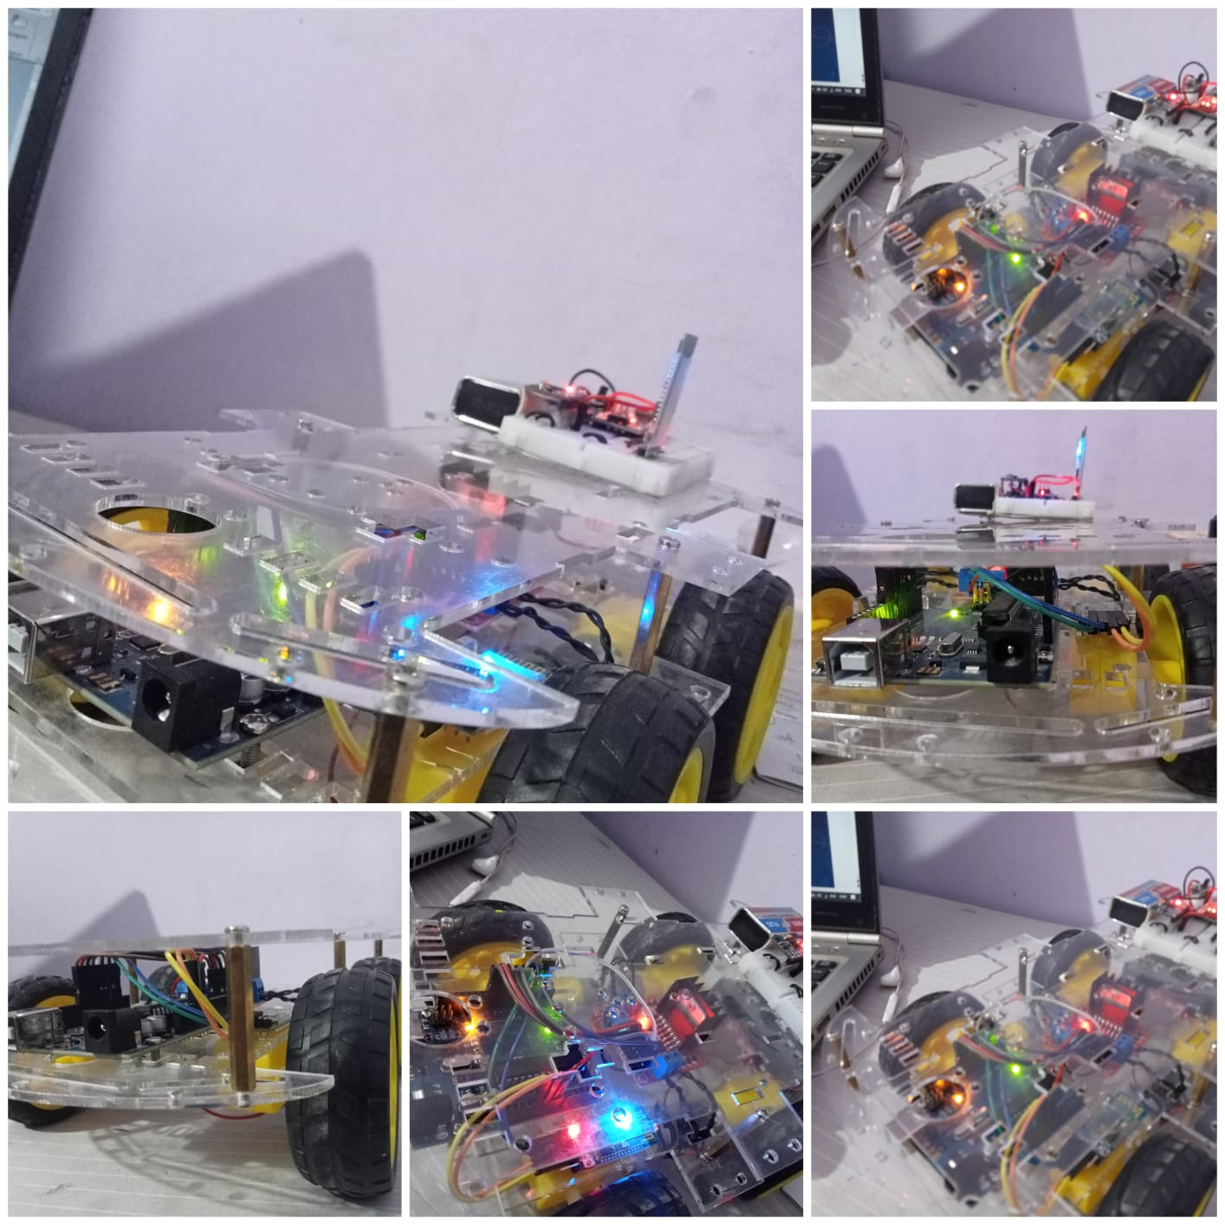
Problem statement
Develop a hand gesture-controlled car using Arduino that can be used to navigate in indoor environments without the need for physical buttons or joysticks. The system should allow users to control the car's movement using a set of predefined hand gestures, such as moving their hand up or down to control the car's speed, or tilting their hand left or right to steer the car. The car should be able to avoid obstacles and follow a pre-defined path autonomously if no hand gesture is detected. The system should be easy to use and reliable, with minimal latency and accurate gesture recognition, and should be suitable for use in a variety of indoor environments, such as classrooms, laboratories, or offices. The project should be implemented using off-the-shelf components and open-source software, and the final system should be well-documented and easy to replicate.

Slide 3




Problem statement
objectives
objectives
Develop a hand gesture-controlled car using Arduino that can be used to navigate in indoor environments without the need for physical buttons or joysticks. The system should allow users to control the car's movement using a set of predefined hand gestures, such as moving their hand up or down to control the car's speed, or tilting their hand left or right to steer the car. The car should be able to avoid obstacles and follow a pre-defined path autonomously if no hand gesture is detected. The system should be easy to use and reliable, with minimal latency and accurate gesture recognition, and should be suitable for use in a variety of indoor environments, such as classrooms, laboratories, or offices. The project should be implemented using off-the-shelf components and open-source software, and the final system should be well-documented and easy to replicate.
Demonstration

Slide 4


objectives
Demonstration
MECHANISM
HARDWARE
&
SOFTWARE
RELATING COSTS

Slide 5
INTRODUCTION
It is designed to navigate in indoor environments without the need for traditional controls.
It eliminates the need for physical buttons or joysticks.
Let’s talk about the main components first
Arduino UNO (Dip)
Arduino Nano
L298N Motor driver
HC05 Bluetooth module

Slide 6
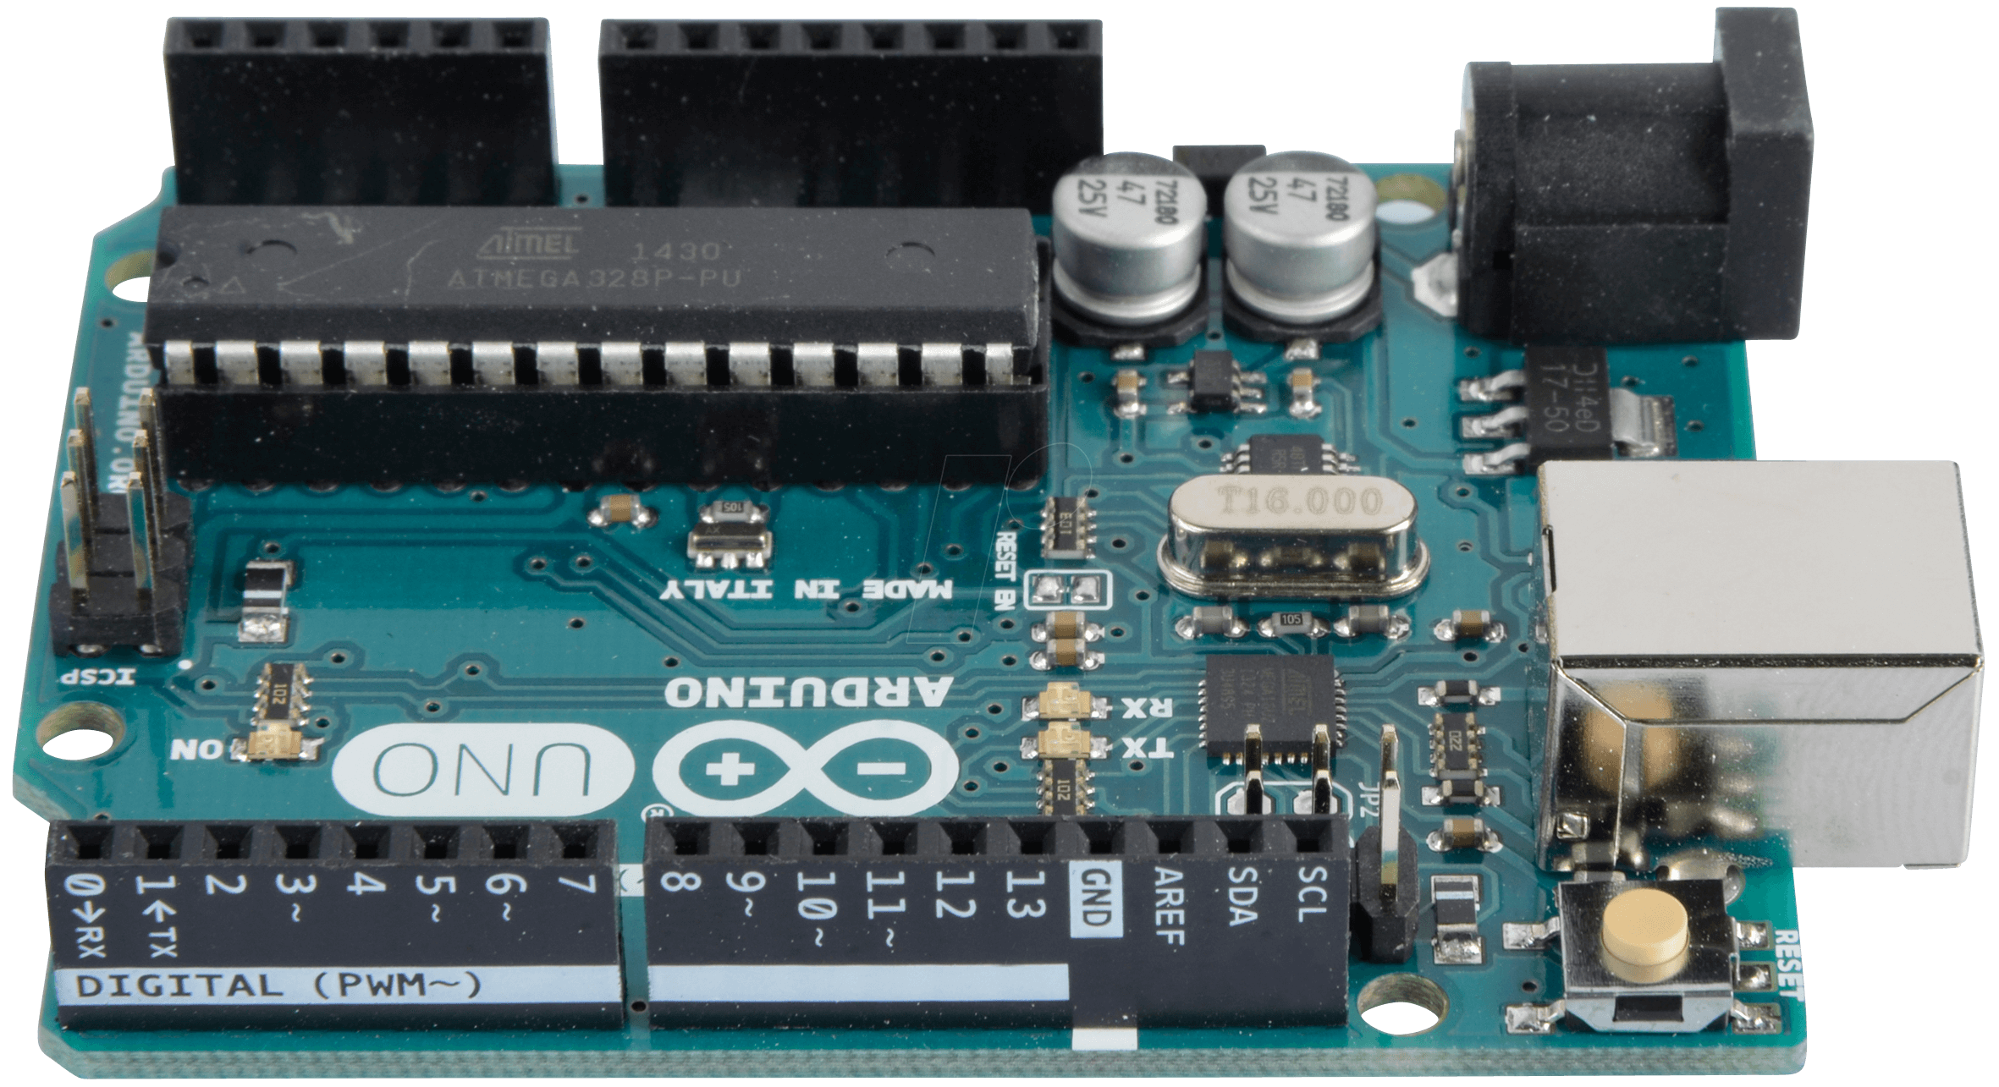
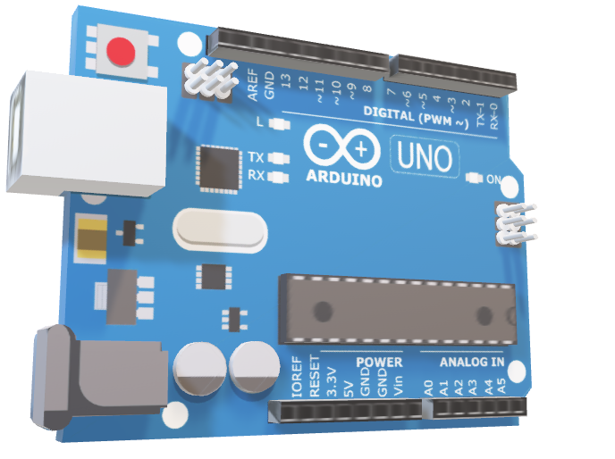
overview
Let’s talk about the main components first
Arduino UNO (Dip)
Arduino Nano
L298N Motor driver
HC05 Bluetooth module

Slide 7
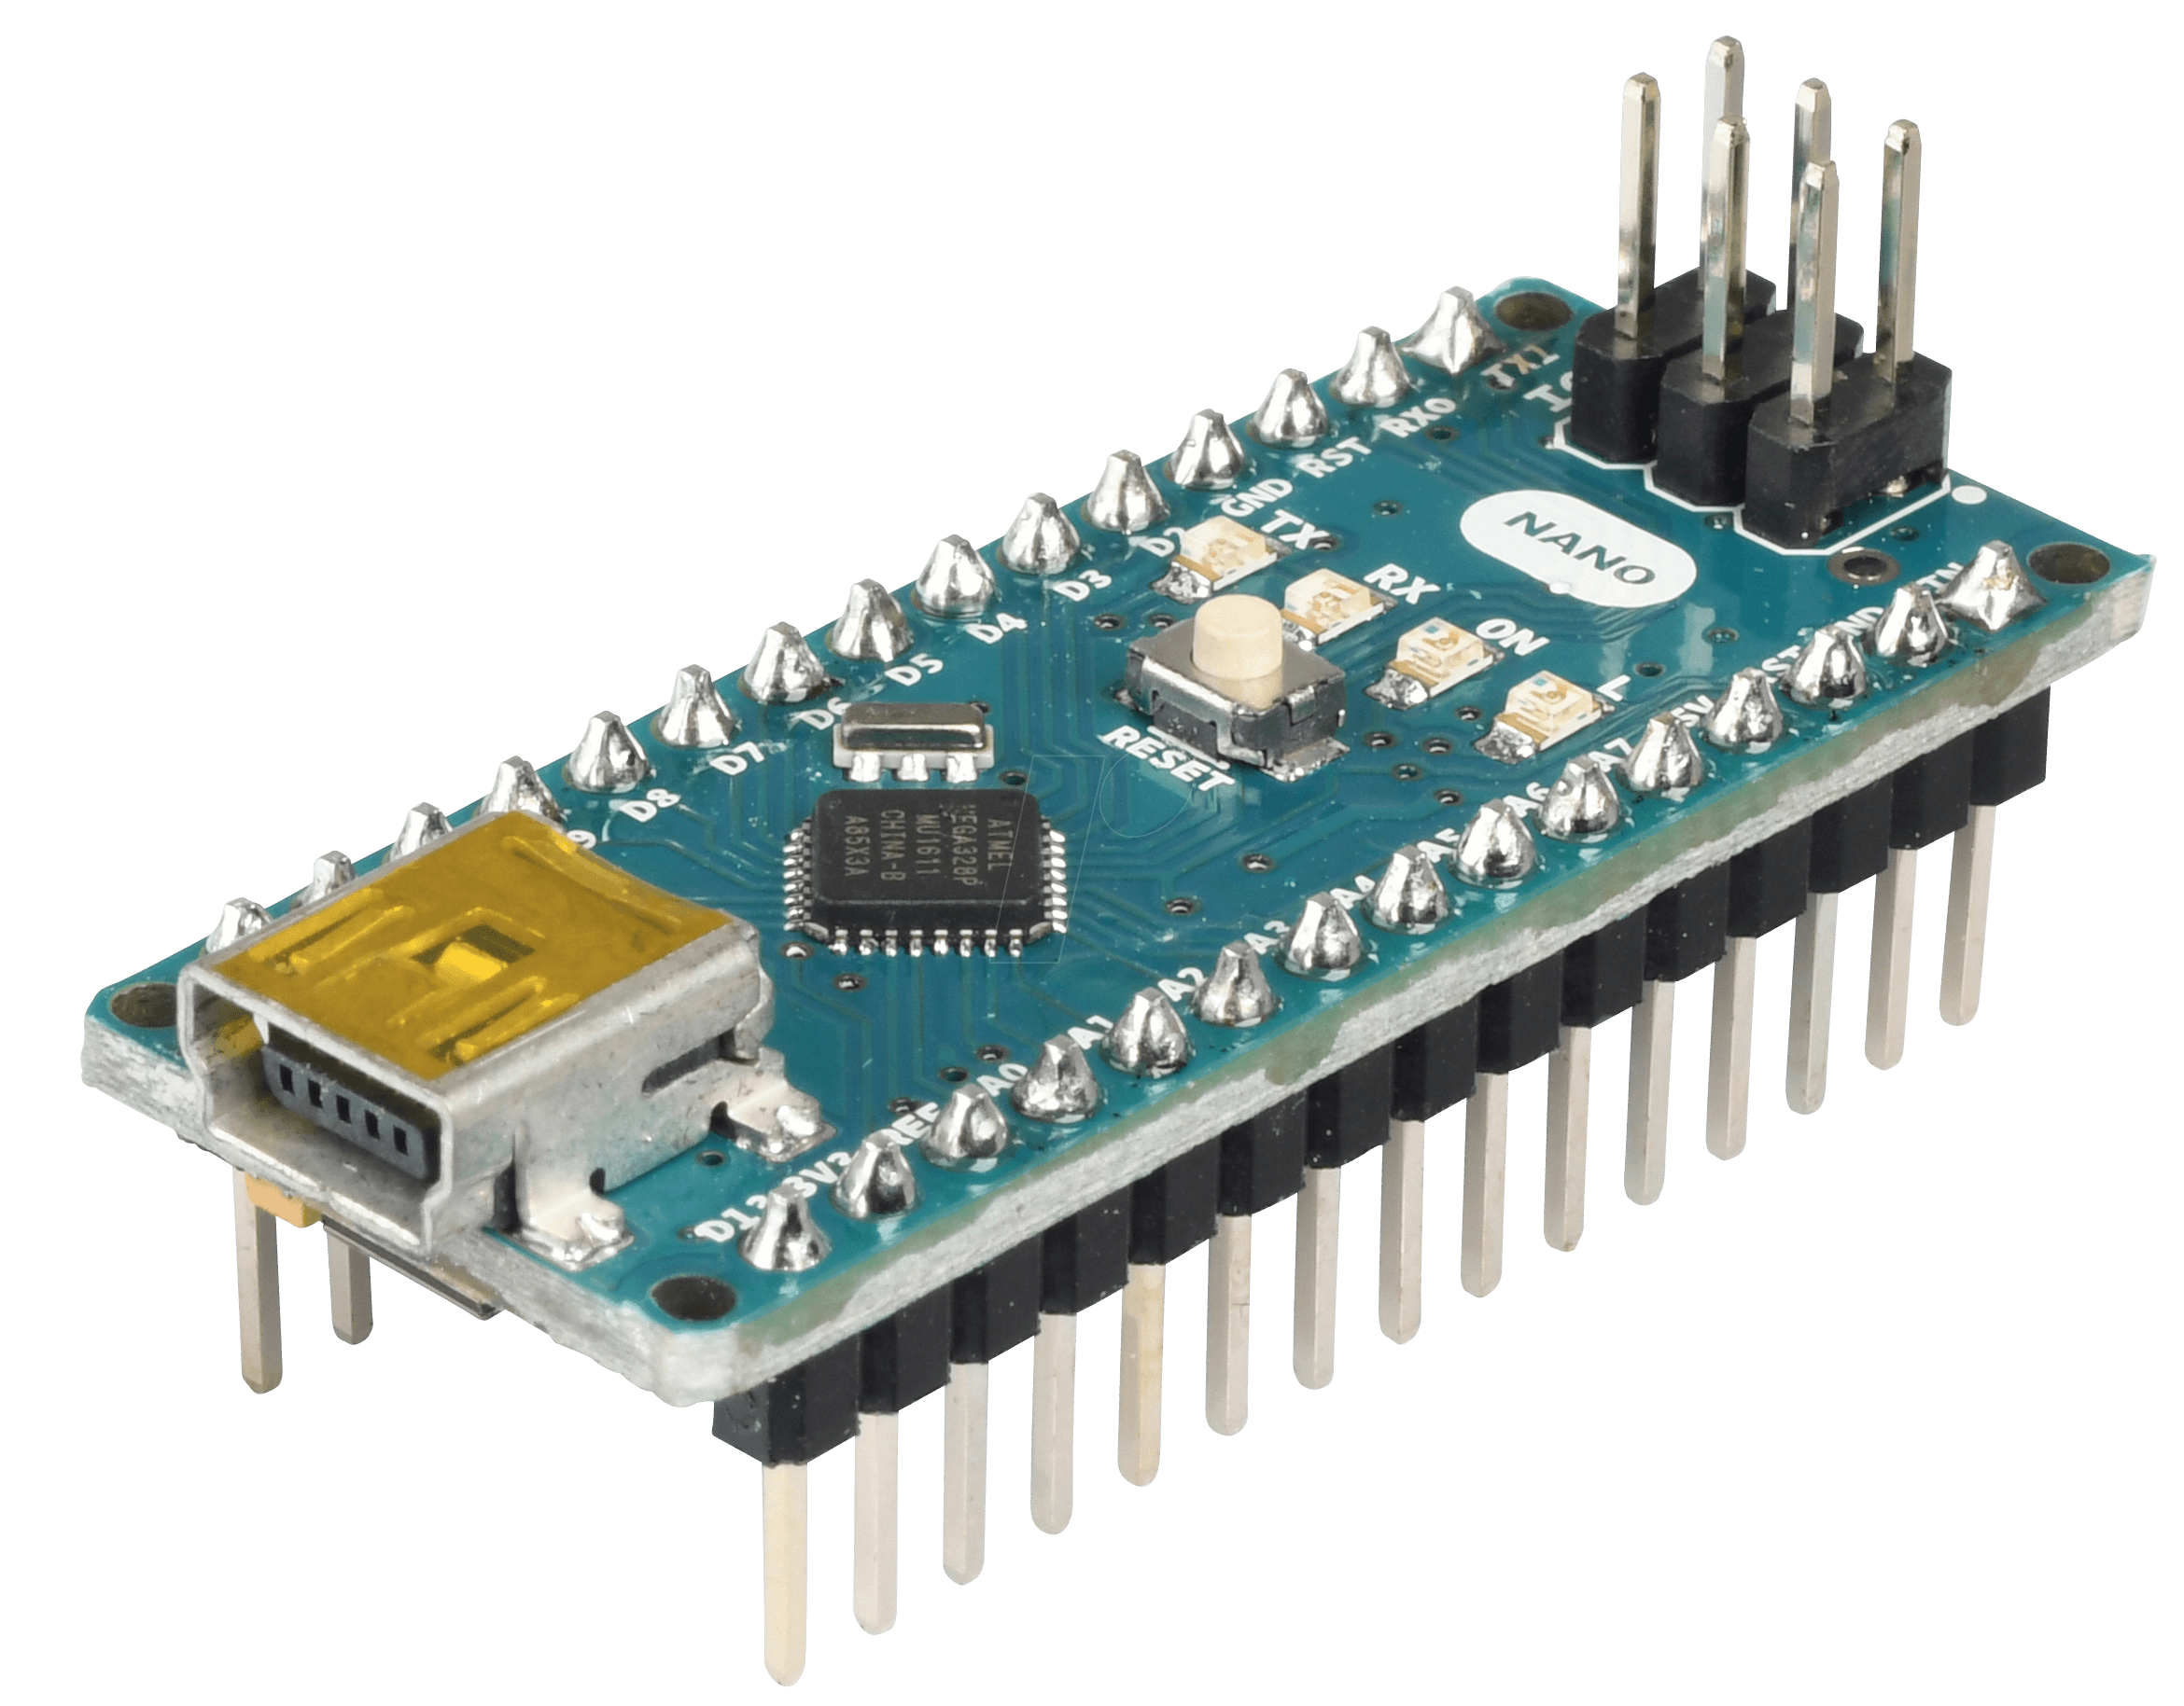
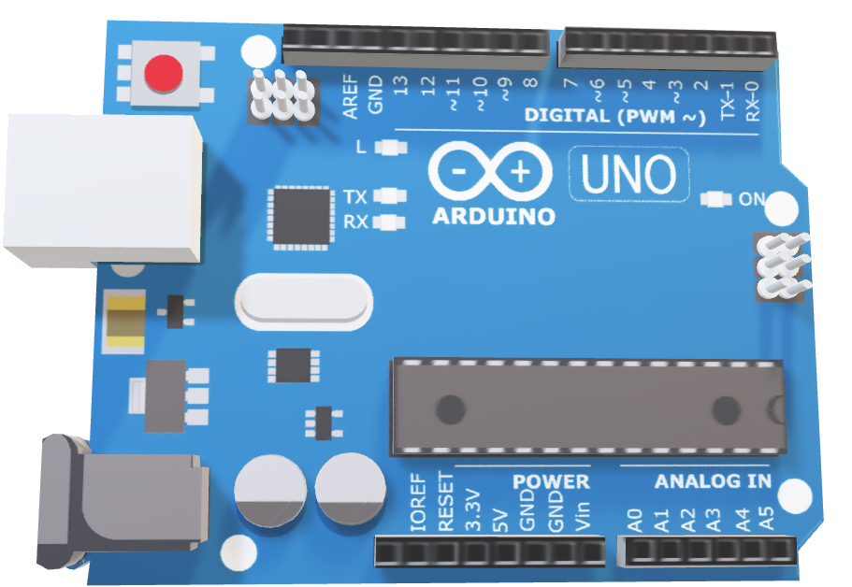
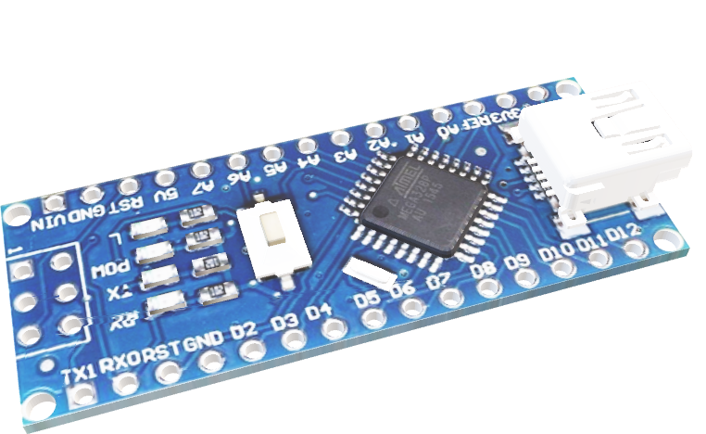
Arduino uno Dip(dual inline package)
The Robot module

Slide 8

Arduino Nano
The remote module

Slide 9
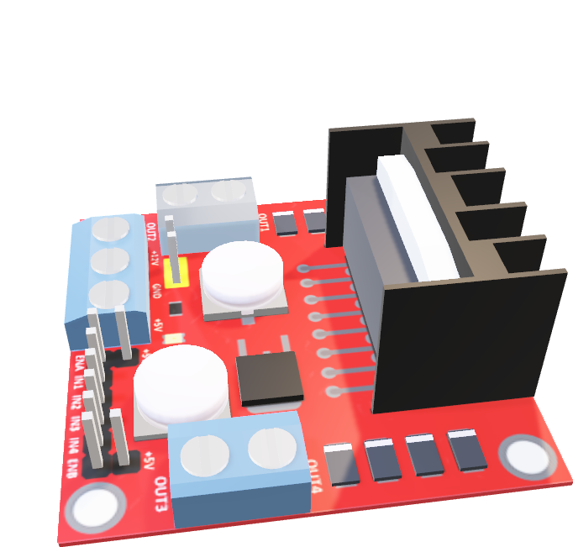
L298n motor driver
The Bridge module

Slide 10
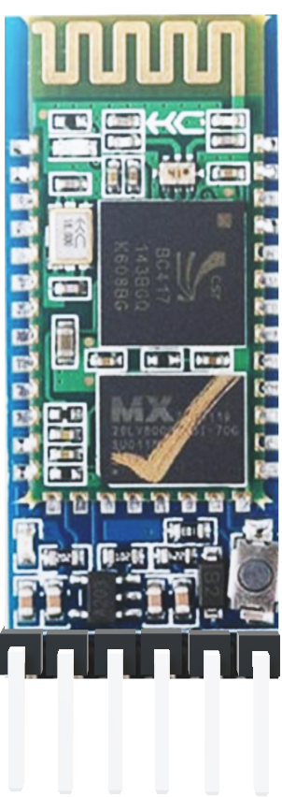
Hc-05 Bluetooth
the Connection

Slide 11
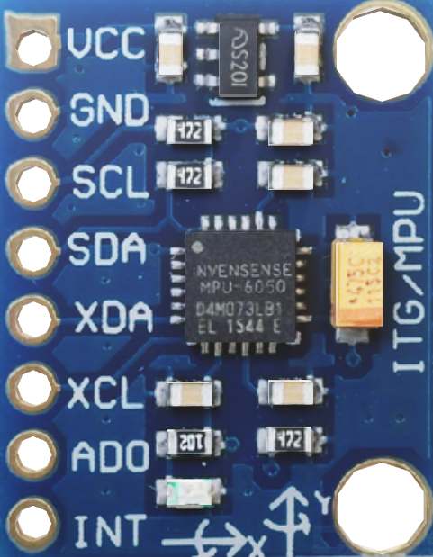
MPU 6050 gyro sensor

Slide 12
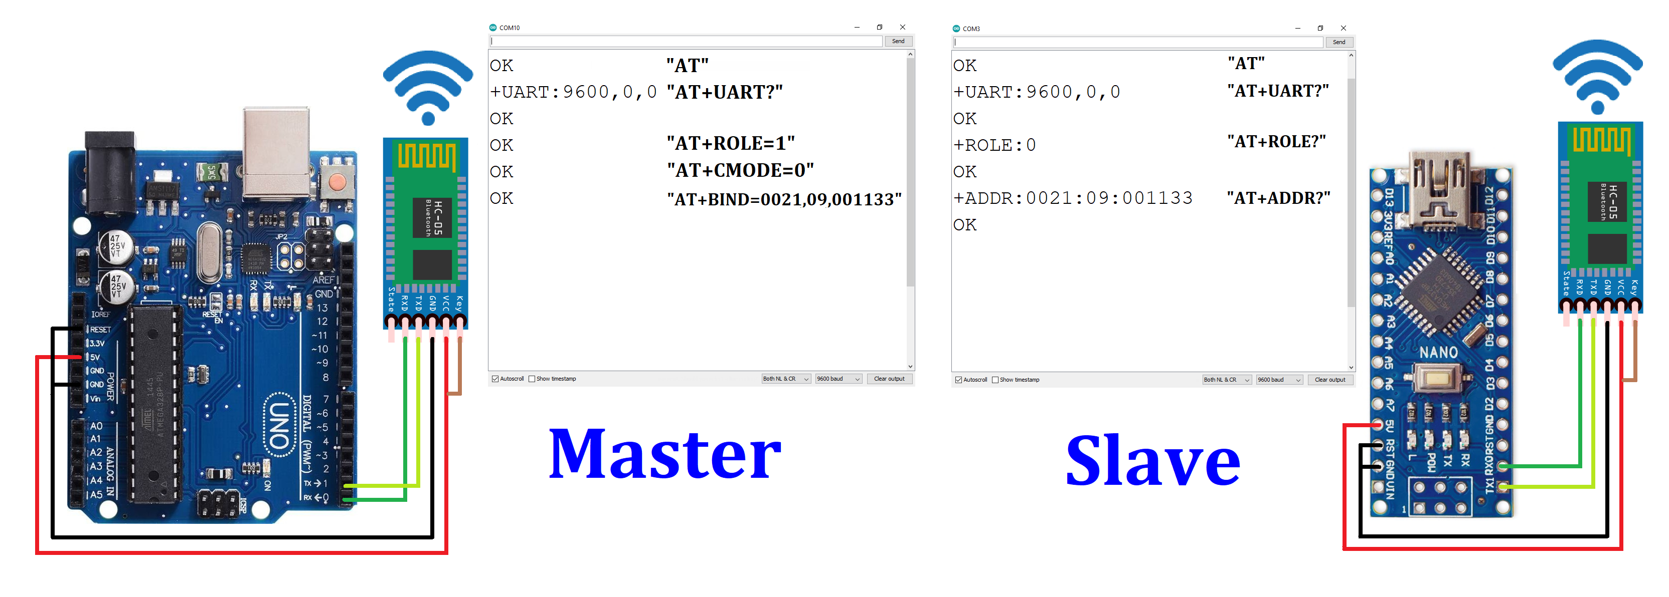
Methodology
Step1 : Pairing two HC05 Bluetooth modules(master & slave)
Step2 : Master modules with Arduino UNO DIP & slave with Arduino Nano
Step 3 : uploading the codes into both Arduino processors

Slide 13
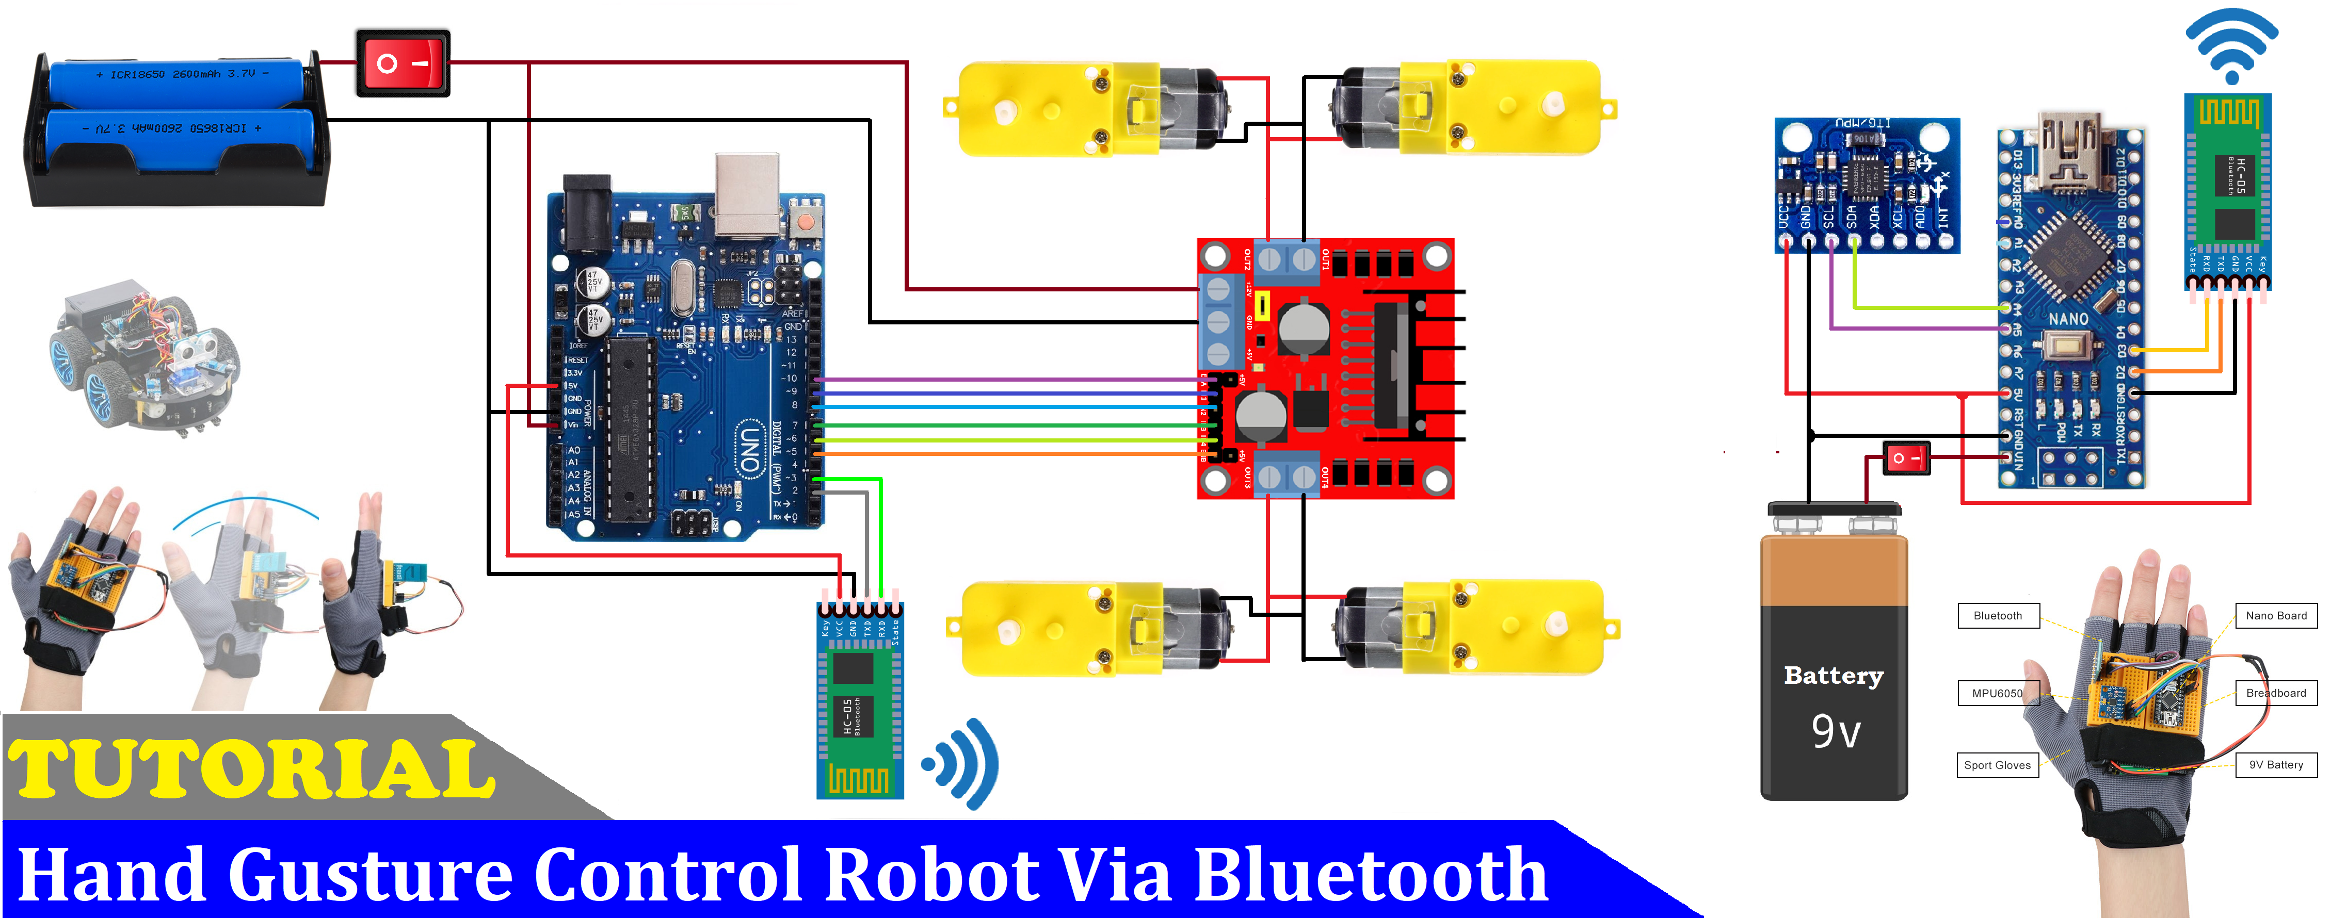
Pairing two hc05 modules

Slide 14
Step 2

Slide 15
HAND CODE
#include <SoftwareSerial.h>
SoftwareSerial BT_Serial(2, 3); // RX, TX
#include <Wire.h> // I2C communication library
const int MPU = 0x68; // I2C address of the MPU6050 accelerometer
int16_t AcX, AcY, AcZ;
int flag=0;
void setup () {// put your setup code here, to run once
Serial.begin(9600); // start serial communication at 9600bps
BT_Serial.begin(9600);
// Initialize interface to the MPU6050
Wire.begin();
Wire.beginTransmission(MPU);
Wire.write(0x6B);
Wire.write(0);
Wire.endTransmission(true);

Slide 16
HAND CODE
delay(500);
}
void loop () {
Read_accelerometer(); // Read MPU6050 accelerometer
if(AcX<60 && flag==0){flag=1; BT_Serial.write('f');}
if(AcX>130 && flag==0){flag=1; BT_Serial.write('b');}
if(AcY<60 && flag==0){flag=1; BT_Serial.write('l'); }
if(AcY>130 && flag==0){flag=1; BT_Serial.write('r');}
if((AcX>70)&&(AcX<120)&&(AcY>70)&&(AcY<120)&&(flag==1)){flag=0;
BT_Serial.write('s');
}
delay(100);
}

Slide 17
HAND CODE
void Read_accelerometer(){
// Read the accelerometer data
Wire.beginTransmission(MPU);
Wire.write(0x3B); // Start with register 0x3B (ACCEL_XOUT_H)
Wire.endTransmission(false);
Wire.requestFrom(MPU, 6, true); // Read 6 registers total, each axis value is stored in 2 registers
AcX = Wire.read() << 8 | Wire.read(); // X-axis value
AcY = Wire.read() << 8 | Wire.read(); // Y-axis value
AcZ = Wire.read() << 8 | Wire.read(); // Z-axis value
AcX = map(AcX, -17000, 17000, 0, 180);
AcY = map(AcY, -17000, 17000, 0, 180);
AcZ = map(AcZ, -17000, 17000, 0, 180);
Serial.print(AcX);
Serial.print("\t");
Serial.print(AcY);
Serial.print("\t");
Serial.println(AcZ);
}

Slide 18
ROBOT CODE
#include <SoftwareSerial.h>
SoftwareSerial BT_Serial(2, 3); // RX, TX
#define enA 10//Enable1 L298 Pin enA
#define in1 9 //Motor1 L298 Pin in1
#define in2 8 //Motor1 L298 Pin in1
#define in3 7 //Motor2 L298 Pin in1
#define in4 6 //Motor2 L298 Pin in1
#define enB 5 //Enable2 L298 Pin enB
char bt_data; // variable to receive data from the serial port
int Speed = 150; //Write The Duty Cycle 0 to 255 Enable Pins for Motor Speed
void setup() { // put your setup code here, to run once
Serial.begin(9600); // start serial communication at 9600bps
BT_Serial.begin(9600);

Slide 19
ROBOT CODE
pinMode(enA, OUTPUT); // declare as output for L298 Pin enA
pinMode(in1, OUTPUT); // declare as output for L298 Pin in1
pinMode(in2, OUTPUT); // declare as output for L298 Pin in2
pinMode(in3, OUTPUT); // declare as output for L298 Pin in3
pinMode(in4, OUTPUT); // declare as output for L298 Pin in4
pinMode(enB, OUTPUT); // declare as output for L298 Pin enB
delay(200);
}
void loop(){
if(BT_Serial.available() > 0){ //if some date is sent, reads it and saves in state
bt_data = BT_Serial.read();
Serial.println(bt_data);
}
if(bt_data == 'f'){forword(); Speed=180;} // if the bt_data is 'f' the DC motor will go forward
else if(bt_data == 'b'){backword(); Speed=180;} // if the bt_data is 'b' the motor will Reverse
else if(bt_data == 'l'){turnLeft(); Speed=250;} // if the bt_data is 'l' the motor will turn left
else if(bt_data == 'r'){turnRight();Speed=250;} // if the bt_data is 'r' the motor will turn right
else if(bt_data == 's'){Stop(); } // if the bt_data 's' the motor will Stop

Slide 20
ROBOT CODE
analogWrite(enA, Speed); // Write The Duty Cycle 0 to 255 Enable Pin A for Motor1 Speed
analogWrite(enB, Speed); // Write The Duty Cycle 0 to 255 Enable Pin B for Motor2 Speed
delay(50);
}
void forword(){ //forword
digitalWrite(in1, HIGH); //Right Motor forword Pin
digitalWrite(in2, LOW); //Right Motor backword Pin
digitalWrite(in3, LOW); //Left Motor backword Pin
digitalWrite(in4, HIGH); //Left Motor forword Pin
}
void backword(){ //backword
digitalWrite(in1, LOW); //Right Motor forword Pin
digitalWrite(in2, HIGH); //Right Motor backword Pin
digitalWrite(in3, HIGH); //Left Motor backword Pin
digitalWrite(in4, LOW); //Left Motor forword Pin
}

Slide 21
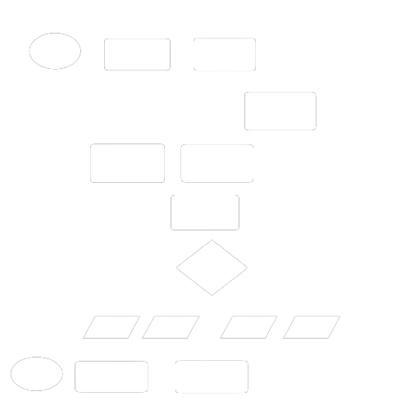
ROBOT CODE
void turnRight(){ //turnRight
digitalWrite(in1, LOW); //Right Motor forword Pin
digitalWrite(in2, HIGH); //Right Motor backword Pin
digitalWrite(in3, LOW); //Left Motor backword Pin
digitalWrite(in4, HIGH); //Left Motor forword Pin
}
void turnLeft(){ //turnLeft
digitalWrite(in1, HIGH); //Right Motor forword Pin
digitalWrite(in2, LOW); //Right Motor backword Pin
digitalWrite(in3, HIGH); //Left Motor backword Pin
digitalWrite(in4, LOW); //Left Motor forword Pin
}
void Stop(){ //stop
digitalWrite(in1, LOW); //Right Motor forword Pin
digitalWrite(in2, LOW); //Right Motor backword Pin
digitalWrite(in3, LOW); //Left Motor backword Pin
digitalWrite(in4, LOW); //Left Motor forword Pin
HC-05 Master

Slide 22


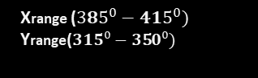
ROBOT CODE
void turnRight(){ //turnRight
digitalWrite(in1, LOW); //Right Motor forword Pin
digitalWrite(in2, HIGH); //Right Motor backword Pin
digitalWrite(in3, LOW); //Left Motor backword Pin
digitalWrite(in4, HIGH); //Left Motor forword Pin
}
void turnLeft(){ //turnLeft
digitalWrite(in1, HIGH); //Right Motor forword Pin
digitalWrite(in2, LOW); //Right Motor backword Pin
digitalWrite(in3, HIGH); //Left Motor backword Pin
digitalWrite(in4, LOW); //Left Motor forword Pin
}
void Stop(){ //stop
digitalWrite(in1, LOW); //Right Motor forword Pin
digitalWrite(in2, LOW); //Right Motor backword Pin
digitalWrite(in3, LOW); //Left Motor backword Pin
digitalWrite(in4, LOW); //Left Motor forword Pin
Arduino Uno
Xrange (${225^{0}−\text{27} 5}^{0})$
Yrange(${320^{0}−\text{34}5}^{0})$
Xrange (${315^{0}−34 5}^{0})$
Yrange(${250^{0}−275}^{0})$
Left
Forward
Car Movement
HC-05 Master
Xrange (${385^{0}−415}^{0})$
Yrange(${315^{0}−3\text{5}0}^{0})$

Slide 23




Hand
gestures
Data
Transfer
Values
Transfer
start
Accelerometer
Arduino Nano
FLOW CHART
Convert data into angles values of range 0-450
Signals
Transfer
HC-05 Slave
HC-05 Master
RF receiver
RF transmitter
Arduino Uno
09. | 40 PIN MALE HEADER | 01 | PKR80.00
10. | ROBOT CHASIS | 01 | PKR1600.00
11. | Hard Jumper wire | 30 cm | PKR150.00
Checking
of angles
Xrange (${325^{0}−34 5}^{0})$
Yrange(${380^{0}−41\text{0}}^{0})$
Xrange (${315^{0}−34 5}^{0})$
Yrange(${250^{0}−275}^{0})$
Xrange (${385^{0}−415}^{0})$
Yrange(${315^{0}−3\text{5}0}^{0})$
Xrange (${225^{0}−\text{27} 5}^{0})$
Yrange(${320^{0}−\text{34}5}^{0})$
Forward
Back
Left
Right
Data Transfer
End
Car Movement
Motor Driver
L298N

Slide 24
S No. | Component | Quantity | Price
01. | ARDUINO UNO (DIP) | 01 | PKR1790.00
02. | ARDUINO NANO | 01 | PKR900.00
03. | L298N MOTOR DRIVER | 01 | PKR350.00
04. | HC-05 BLUETOOTH MODULES | 02 | PKR1300.00
05. | MPU-6050 GYRO SENSOR | 01 | PKR350.00
06. | 2 PIN CELL HOLDER | 01 | PKR100.00
07. | BATTERY CLIP | 01 | PKR10.00
08. | BREAD BOARD | 01 | PKR200.00
09. | 40 PIN MALE HEADER | 01 | PKR80.00
10. | ROBOT CHASIS | 01 | PKR1600.00
11. | HARD JUMPER WIRE | 30 cm | PKR150.00
12. | JUMPER WIRES | 20 | PKR100.OO
13. | OG CABLE FOR ARDUINO | 02 | PKR250.00
14. | 3.7V CELL | 02 | PKR400.OO
15. | 9V BATTERY | 01 | PKR100.00
16. | SWITCHES | 02 | PKR40.00

Slide 25

Thank You!

